Slide 1
AQUAPONICS
Exploring science (CAT-1)
Team - Aztics

Slide 2
OUR OBSERVATION
Change in hardness of the water | Change in pH | Change in temperature | The effect on plants | The effect on fishes | Overall output
90 PPM | 7.2 | 28.5 degree Celsius | Not ideal growth due to slightly basic pH. | Not ideal as softer water promotes slower growth of fishes | Not as good as expected but growth was observed in both plants and fishes.
160 PPM | 7.8 | 27 degree Celsius | The basic medium and hardness of water make the plants dry | The excess hardness stunts the growth of fishes | The wrong combination of parameters caused worse effect on our project
130 PPM | 6.9 | 26 degree Celsius | Almost ideal growth of plants due to the availability of slightly acidic medium | Almost ideal growth of fishes. | We concluded this to be the most ideal combination for our model and hence the inference of our analysis.

Slide 3
CONCLUSION
The methods used to calculate the data is hardening of water using the water filter, calculating the pH using the litmus paper and changing the temperature of the water. Due to less time in hand, we couldn’t calculate and change dissolved oxygen and nitrogen in the water. We observed the data and tabulated the observation to find the most ideal combination for the project.
The inference drawn from the analysis was increase in the hardness of water, increased the growth of fishes making them plump which further prompted an increase of nutrients which escalated the growth of plants comparatively, the pH of the water played a very important role as fishes preferred slightly basic medium but the plants preferred acidic and increasing the temperature of water did benefit the fish’s growth but didn’t escalate the growth of plants. So, the most ideal combination of parameters we concluded was 130ppm hardness of water, 26.5-degree Celsius temperature and a pH of range 6.6 to 7.6.

Slide 4
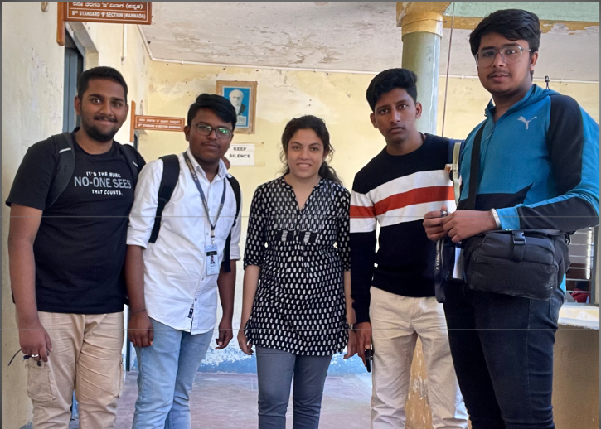
Team: AZTICS
R V University (1st year B-Tech)

Slide 5
THANK YOU

